Slide 1
Vocational trainning center for undergraduate university students and teacher in Jordan (VTC)
Partner Presentation, Kick-off Meeting
Dead Sea, Jordan
24/02/2015
Pedro Valente
pedro.valente@ispab.pt
Avenida Escolar, Apartado 99 - 4536-906 Paços de Brandão
Telefones: (+351) 227 449 277 / 227 451 005
Telemóvel: (+351) 919646990 - Fax: (+351) 227 451 009
geral@ispab.pt – www.ispab.pt

Slide 2
Who/Where We Are
ISPAB – Instituto Superior de Paços de Brandão
Portuguese Private Polytechnic Institute for Higher Education
Located in Paços de Brandão city
35km south of Oporto
30km north of Aveiro
Near seacoast
Founded in 1990

Slide 3
Looking arround…

Slide 4
Contextualization
Strong connection with industry hub
ISPAB develops its educational activities, training and scientific knowledge in 2 expertise domains:
administration/ accounting,
managerial communication (marketing, public relations and publicity) domains.
Apparel Design for industry/manufacturing (waiting approval)

Slide 5
Connection with the Industry
ISPAB is part of Santa Maria da Feira municipiality
Industries:
Cork processing/manufacturing
Shoe manufacturing
Plastic injection molds
Paper, Carton and Packaging
Industries demands Higly specialized professionals, and continues trainning

Slide 6
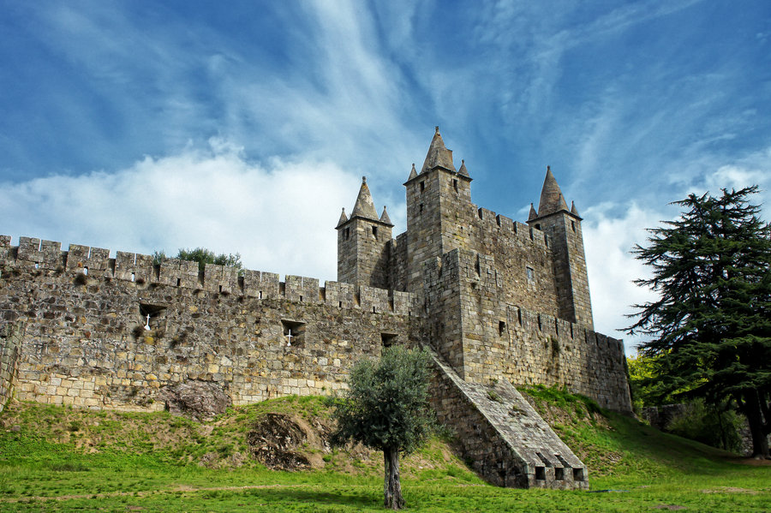
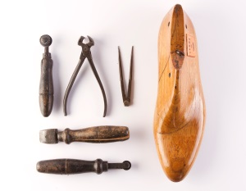

Slide 7
Institutional Structure
FEDESPAB (non profit foundation)
EPPB (professional school – highschool)
Trainning and competencies center
ISPAB (Higher Education)

Slide 8
What We Offer
Being a polytechnical higher education system, ISPAB provides a more practical training and is profession-oriented:
Long-life training programs
Isolated curricular units
Bachelors
Posgraduation programs
Masters (in cooperation with other universities)
Higher Technical Professional Programs

Slide 9
LongLife training programs
Under Operational Programme Human Potential (POPH) – European Social Fund
Our offer:
Pedagogical Training of Trainers CCP (formerly CAP)
Modular Training Certified – based on National Qualifications Catalogue (CNQ).
Free courses

Slide 10
Higher Technical Professional Programs (CTeSP)
It's a cycle of higher education for two years
Classified as higher vocational technical course
does not award an academic degree, but rather, of a Higher Professional Technician diploma,
corresponding to level 5 of the National Qualifications Framework
Our offer:
Accounting and Management
Marketing, Retail and Sale

Slide 11
Bachelors degrees
3 years
Accounting and management
Marketing, Advertising and Public Relations

Slide 12
Posgraduation programs
Environmental management
Financial management
Quality management
Health and Safety at Work
Event Marketing
Marketing and Communication Department

Slide 13
Masters
In cooperation with 2 universities (UPT, IPAM) – located in Oporto and Aveiro
Our offer:
Finances
Administration and Management Education
Marketing management

Slide 14
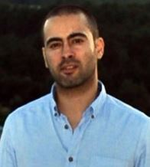
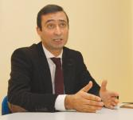
Prof. Pedro Ricardo da Nova Valente, PhD, MSc, Beng. (coordinator)
Software Engineering domain
Auxiliar professor at ISPAB
Invited professor at UPT, Oporto
Trainee
Participation in national Higher Education task-group for Quality and good pratices
Délio Carquejo, MSc
President of ISPAB
Masters degree at the University of Beira Interior, in the area of Sociology
Doctorate study on the analysis of the Virtual Tutoring in formative orientation process, on the model of the European area of higher education

Slide 15
Thanks for your patience!
Instituto Superior de Paços de Brandão (ISPAB)
Avenida Escolar, Apartado 99 4536-906 Paços de Brandão
Telefones: (+351) 227 449 277 / 227 451 005
Telemóvel: (+351) 919 646 990
Fax: (+351) 227 451 009
QR Code - PDF Slides

