Slide 1
Communication Skills
Or,
Have you heard what
I think I’ve said?

Slide 2
Getting to know each other
Janice – An introduction
Carol – An introduction
Dea – An introduction
About you...

Slide 3
Course Aim
To enable delegates to learn more about communication skills, and to practice in a safe environment

Slide 4
Course Objectives
By the end of the course, delegates should have:
A better understanding of the role and importance of Natura 2000 sites and networks
A better understanding of how to communicate effectively, particularly within the context of Natura 2000
An insight into the purpose of communication strategies, include communication within and outside the organisation
Exposure to, and experience of, new communication skills, including written communication, presentation skills, feedback and listening skills.
Discussed some techniques for two-way communication with groups, such as negotiation and facilitation techniques
Throughout this course, time will be given to reflect on techniques used and to actively have a go.

Slide 5
Course Programme
Setting the Scene
Introductions to each other
Introductions to course
An Introduction to Natura 2000
Communication in Protected Areas
Communication Strategies with Organisations

Slide 6
Continue
Developing your Personal Communication Skills
Energiser and re-cap on yesterday
Personal Communication skills, including:
  Verbal/Non-verbal communication
  Active listening
  Assertive, not aggressive
  Giving and receiving feedback
  Written communication

Slide 7
Continue
Developing your skills for communication with a wider audience
Enlivener and re-cap on course so far
Effective ways of communicating with groups
Interpretation techniques
Presentation skills

Slide 8
Continue
Being more effective in two-way communication
Enlivener and re-cap
Facilitation techniques
Negotiation and Conflict resolution
Online Communication

Slide 9
Continue
More two-way communication
Enlivener and re-cap
Talking to the media
Action planning
Sharing your skills – Cascade learning
Action planning
Conclusions and finish

Slide 10
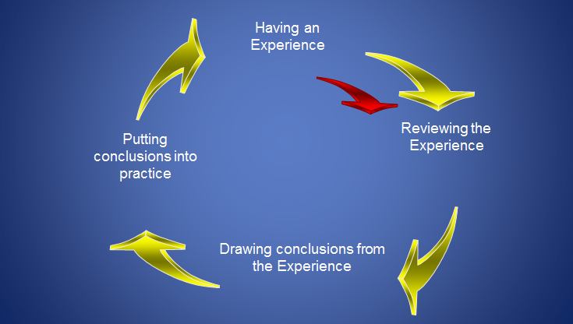
Learning Cycle
Having an Experience
Having an Experience

Slide 11
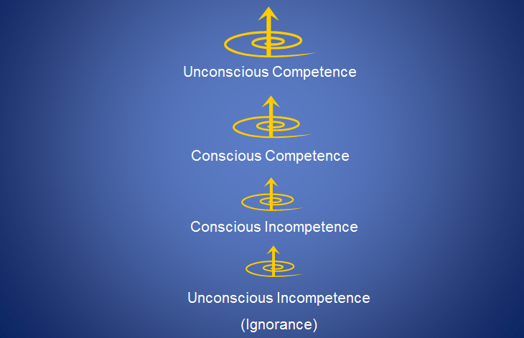
Spiral of understanding skills

Slide 12
What is Effective Communication?

Slide 13
What is effective communication?
In groups, try to come up with a definition of communication.
According to the Collins Essential English Dictionary (2006, 2nd edition), it’s a noun meaning...
1. the exchange of information, ideas, or feelings
2. something communicated, such as a message
3. communications means of travelling or sending messages
It’s an art as much as a science

Slide 14
What is Effective Communication?
Information

Slide 15
The reality...
Information

Slide 16
Potential influences
Body Language/
Non-Verbal Communication
Language used
Existing knowledge
Assumptions
Context
Memory
Attitudes
Stress
Clarity
Culture
Listening skills
Writing skills

Slide 17
Why does it matter?
What happens when communication doesn’t work properly?
NEXT!
Learn more about Natura 2000 and why it is important in protected areas that we communicate clearly and effectively

