Slide 1


Vocational Training Center for Undergraduate University Students and Teachers in Jordan
(VTC)
VTC Project Implementation at AABU
BY
Dr. Mohammad Al-Smairan
Al al-Bayt University
August 5, 2018

Slide 2
Vocational Training Center for Undergraduate University Students and Teachers in Jordan
(VTC)
Overview
Achieved Tasks in Development Work Packages
Achieved Tasks in Dissemination Work Packages

Slide 3
Development Activities

Slide 4
Achieved Tasks
A report on market need analysis was prepared
A IT specialist was assigned
Teaching and learning programs for the VTC were prepared
Vocational Training Center
Workshops and trainings in career planning and career startup were conducted

Slide 5
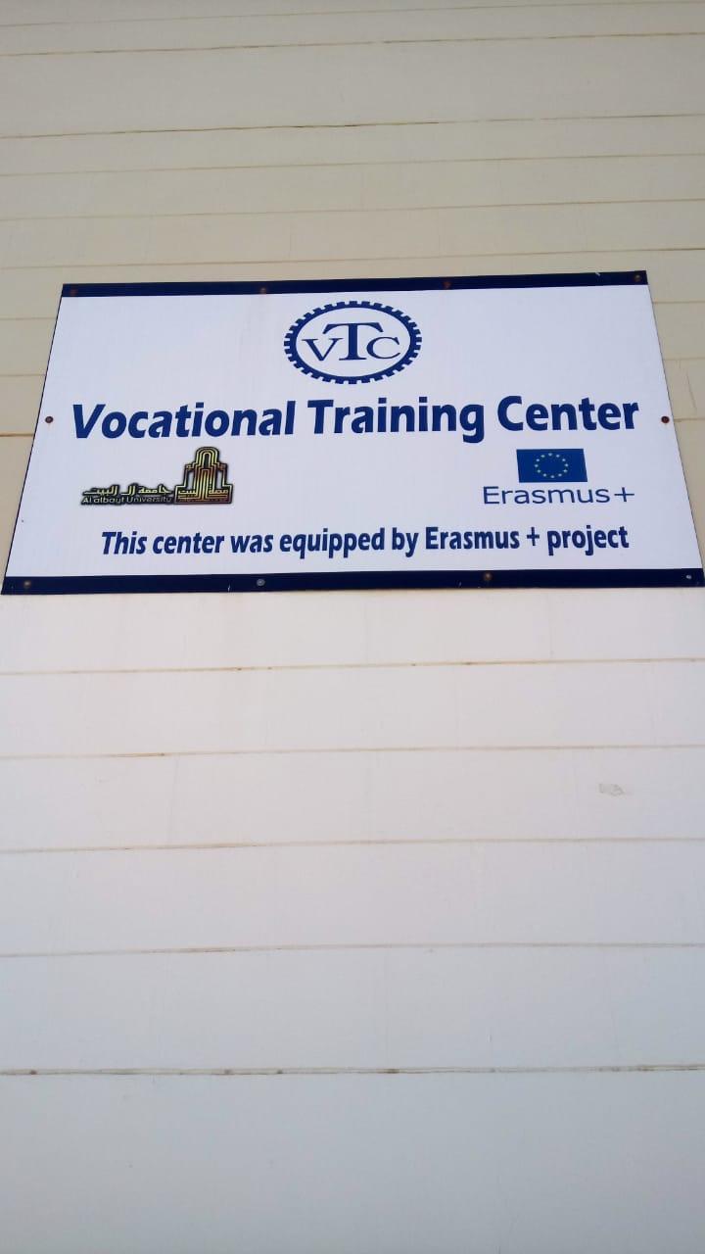
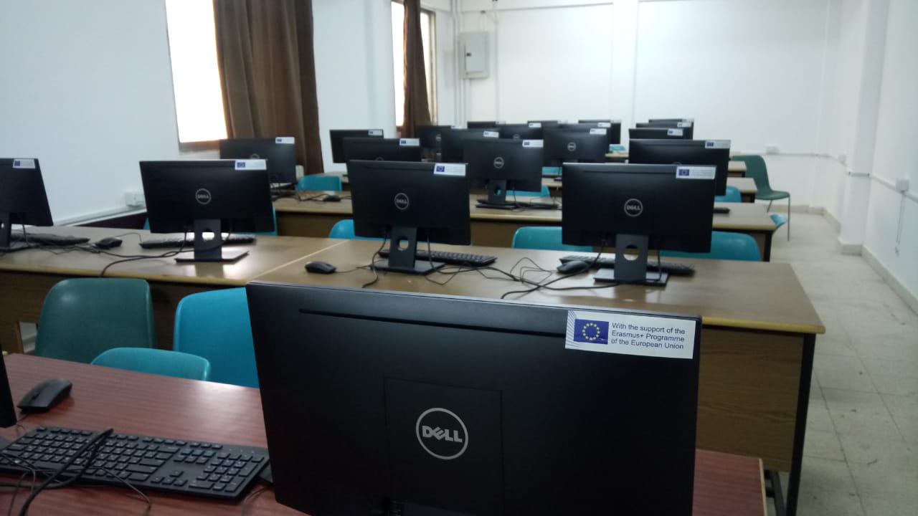
VTC was established at School of Engineering

Slide 6
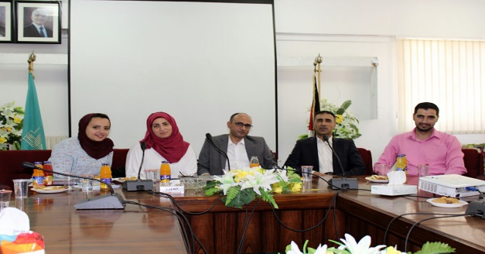
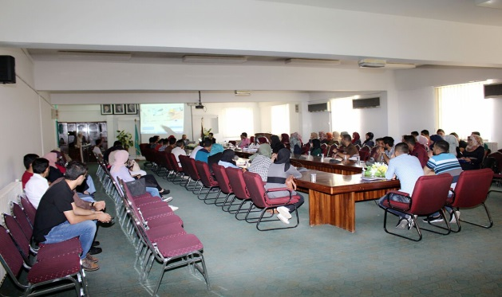
Career Planning for Undergraduate Students Training Workshop at Al al-Bayt University
Training Date: August, 13, 2017
Location: Al al-Bayt University
Trainer: Dr. Khaled Khrisat form MONOJO company
The training was one of the proposed activities in the Vocational training center for undergraduate university students and teacher in Jordan as one of the objectives of Capacity Building in the Field of Higher Education in the Jordanian Universities.
The training topics was according to the output of the questionnaire distributed among the students and policy makers.
The training program focus on an important issues and skills that needs by students.

Slide 7
Cloud Computing Training Workshop at Al al-Bayt University
Training Date: October, 22, 2017
Location: Al al-Bayt University
Trainer: Eng. Ahmed Al-Madan
The training was one of the proposed activities in the Vocational training center for undergraduate university students and teacher in Jordan as one of the objectives of Capacity Building in the Field of Higher Education in the Jordanian Universities.
The training topics was according to the output of the questionnaire distributed among the students and policy makers.
The training program focus on an important issues and skills that needs by students.

Slide 8
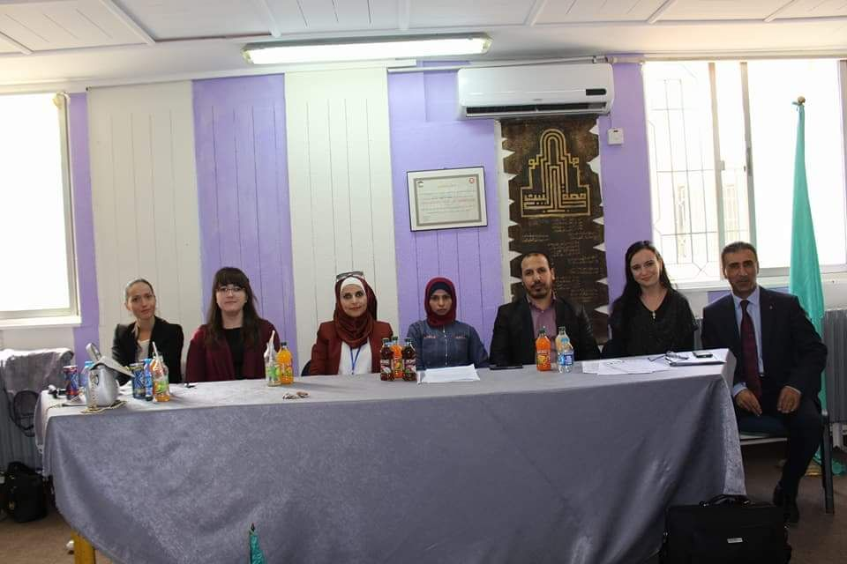
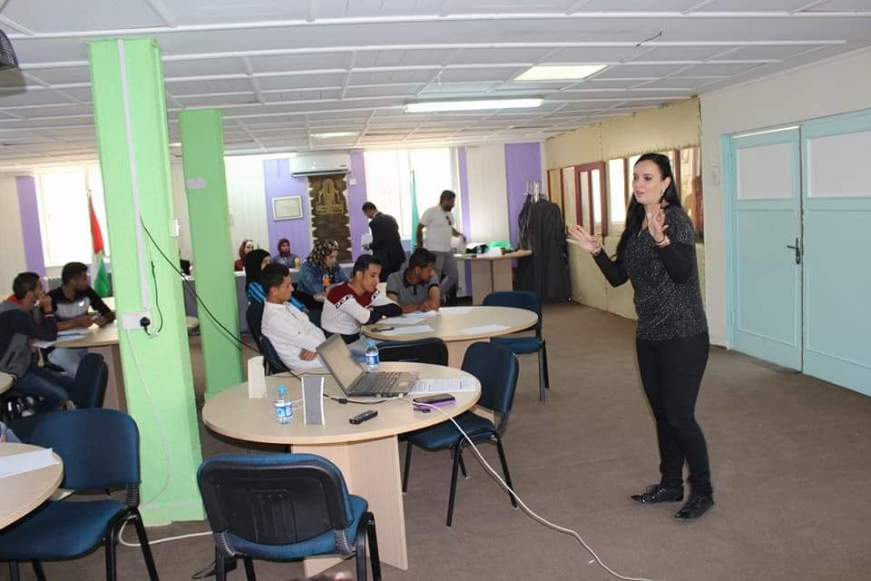
SLOVAK Training Workshop at Al al-Bayt University
October, 25, 2017
Training was conducted by Slovak University of Agriculture in Nitra, aimed to improve:
1- Sales and Marketing Skills: Contrast in International Marketing between Chosen European – Asian – African Countries.
2- Global Citizenship Education – Critical Thinking in Solving Problems and New Ideas.
3- Basic Fundamentals in Project Management: Internationalization, Networking and Project Cooperation Opportunities in Higher Education.

Slide 9
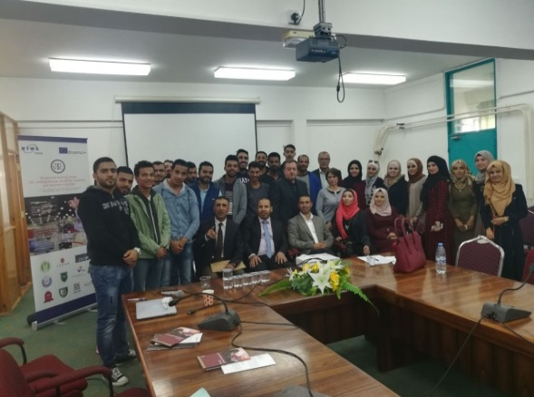
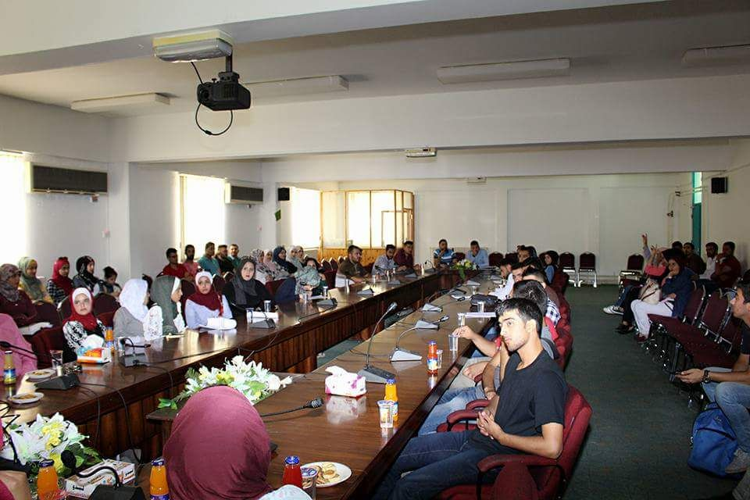
PORTUGAL Training Workshop at Al al-Bayt University
November, 15, 2017
Training was conducted by ISPAB, aimed to improve:
Customer Essential Elements of a Customer Management Approach.
Sales and Marketing Skills: Strategy and Tactics.
History, Heritage and Development: The Touristic Activity.

Slide 10
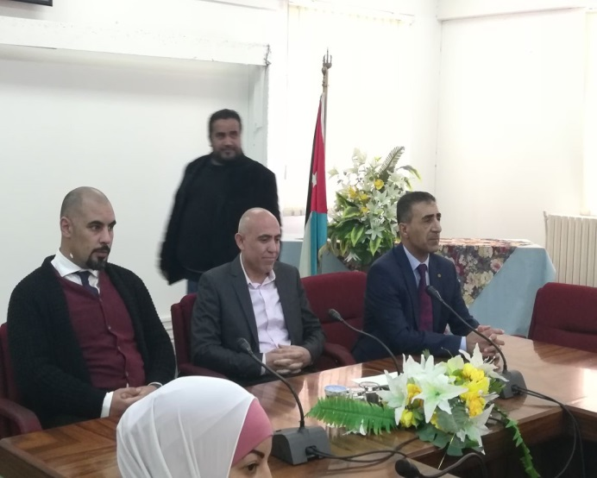
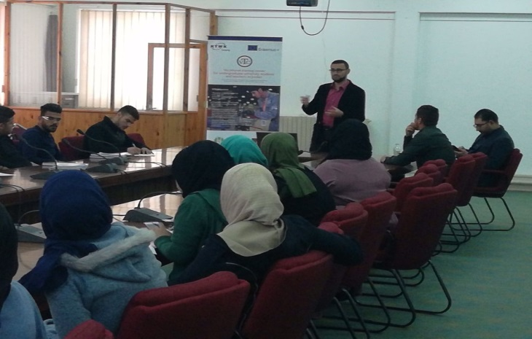
MONOJO Training Workshop at Al al-Bayt University
Time and place: April, 11, 2018
Location: Al al-Bayt University
Trainer: MONOJO company team
The training was one of the proposed activities in the Vocational training center for undergraduate university students and teacher in Jordan as one of the objectives of Capacity Building in the Field of Higher Education in the Jordanian Universities.

Slide 11
Dissemination Activities

Slide 12
Prepare the Third Issue of Newsletter
Coming Soon

Slide 13
VTC Website
Coming Soon

Slide 14
Thank you for your attention

