Slide 1
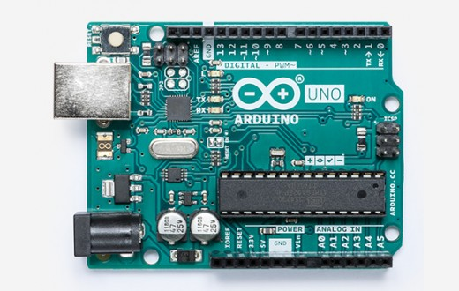
Arduino Workshop
University of Jordan

Slide 2
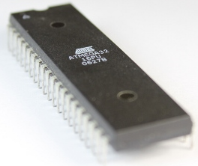
What is Microcontroller??
Microcontrollers are small computers integrated into a single chip
They contain
Processing core
Flash Memory for program
I/O peripherals
RAM
Peripherals such as clocks,timers,PWM etc
Microprocessors are used for general purpose applications, while microcontrollers are self sufficient and are used for specific tasks.
Microcontrollers are an example of embedded systems.

Slide 3
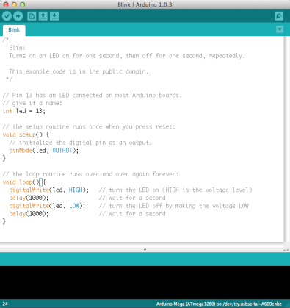
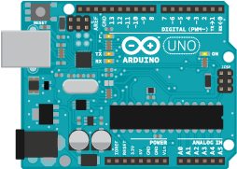
What is Arduino?
An open-source hardware and software platform for building electronics projects
A physical programmable circuit board (often referred to as a microcontroller)
A piece of software, or IDE (Integrated Development Environment) that runs on your computer, used to write and upload computer code to the physical board (supports Mac/Windows/Linux)

Slide 7
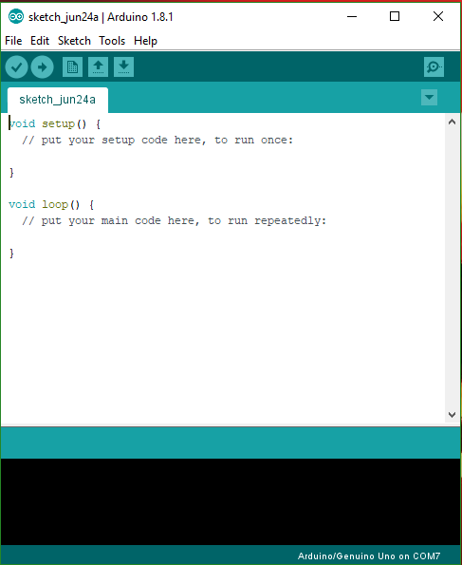
Arduino IDE

Slide 8
Digital or Analog?
All physical quantities are analog.
Analog means that the quantity can take any value between its minimum value and maximum value.
Digital means that the quantity can take specific levels of values with specific offset between each other.
Ex: 1- Digital:
English alpha consists of 26 letter, there is no letter between A and B.
- Square waves are Digital.
Ex.: 2- Analog:
Temperature, can take any value[-1,12.8,25.002,… etc.].
- Sine waves are analog.
Digital and analog.

Slide 10
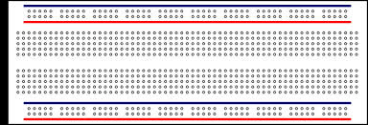
Breadboard Layout
Connected dots represent connectivity

Slide 11
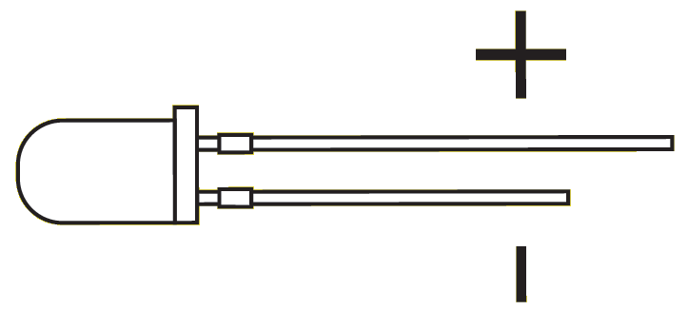
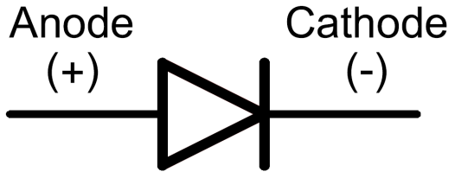
LED BASIC
How to tell between anode and cathode?

