Slide 1
Vocational training center for the undergraduate university students and teachers in Jordan (VTC)
WP4: Purchase of teaching and equipment and bibliographic material
Dr. Ziad Abu El-Rub

Slide 2
GJU Role in the VTC Project
Partner no | PIC | Role | Organization name | City | Country
P7 | 996241702 | Partner organization | GJU | Amman | Jordan
 | WP Title | WP Leader | WP Co-Leader | Duration
WP4 | Purchase of teaching equipment | GJU, JUST | All JO Partners | 15.6.16 – 15.04.17

Slide 3
GJU Team
GJU Contact Person
Ass. Prof. at the Pharmaceutical and Chemical Engineering Dept.
Practical experience in leading positions involving development manager and regional manager in the oil and gas industry.
Professional Engineer (JPE) in Bioenergy Engineering from the Jordan Higher Council for Professional Qualifications and Accreditation, 2015.
A aboard member of the Chemical Engineering Division (2015-2018) at the Jordan Engineers Association
Research areas: bioenergy, and shale oil production
PhD in Chemical Engineering from the University of Twente, the Netherlands, 2008.
MSc in Technological Design from the University of Twente, the Netherlands, 2002.
BSc in Chemical Engineering, University of Jordan, Jordan, 1998
Dr. Ziad Abu El-Rub
ziad.Abuelrub@gju.edu.jo

Slide 4
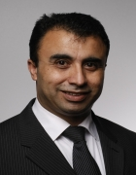
GJU Team
Vice Dean of School of Applied Medical Sciences
PhD in 2011 at the Nanotechnology and Integrated Bioengineering Centre (NIBEC), University of Ulster in the UK.
Researching the impedimetric sensor for label-free point-of-care immunoassay cardiac marker systems as Laboratory-on-a-Chip devices in the field of Nanotechnology.
Worked as a research assistant at the Nanotechnology and Integrated Bioengineering Centre
Research area: development of point-of-care (POC) diagnostics for global health initiatives.
A member of several associations such as
Jordan Engineers Association (JEA), Jordan
Institute of Engineering and Technology (IET), UK
Verein Deutscher Ingenieure (VDI), Germany.
Dr. Eyad Hamad
Eyad.hamad@gju.edu.jo

Slide 5
GJU Role – WP4
Work Package 4 (WP4): Purchase of teaching equipment and bibliographic material
Task 4.1: selection of equipment
Task 4.2: Implementation of the center

Slide 6
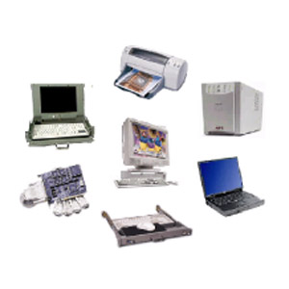
Task 4.1: Selection of the equipment
Hardwares
Computers
Printers
Scanners
Beamers
Servers for e-learning
Cables
Interactive whiteboards
accessories
Softwares
MS Windows and MS Office
Antivirus
Internet access
E-learning Softwares
Deadline: 15.10.2016

Slide 7
Task 4.2: Implementation of the center
Definition of tender specifications and procurement procedures
Prepare final lists of equipment and bibliographic materials
Collect local offers
Ensure that the selection respects the principle of “best value for money”
Purchase of computers
Create a base of e-learning
Purchase of materials and installation of equipment
Establishment of the office for the VTC
Deadline: 15.9.2017

Slide 8
Thank you!

