Slide 1
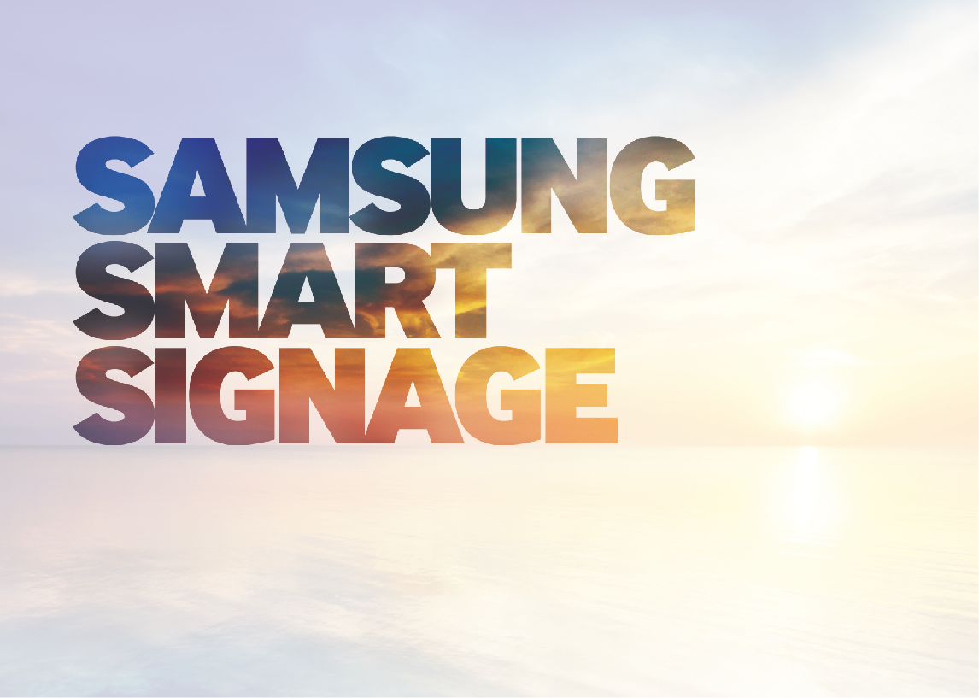
Sssp vs. TV

Slide 2
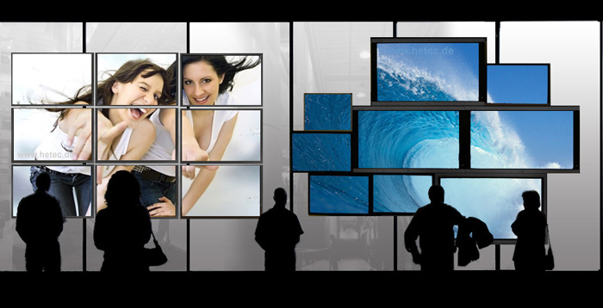
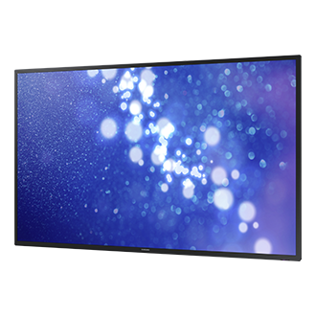
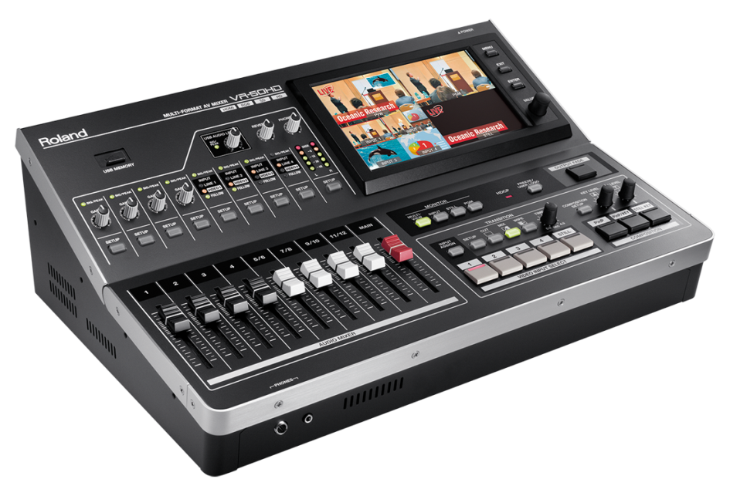

Slide 3
Built Tough “High Reliability”
• LFD quality assurance test standard is more strict than TV to meet customers expectation
Subject | Purpose | TV | LFD
Accelerated Life Time ( ALT ) | Assure targeted failure rate | Condition : 50℃, 1000hrs Test, | .conditions : 50℃,2000hrs Test (10 ~ 20대)
Long time life cycle | Assure possible failures after Long usage time. such as, Mura, lamp brightness decrement, image sticking and so on | 35℃±5℃ duration 3000hr | Normal condition: 25℃,5000hrs - high temperature : 40℃, 8700hrs - Inside enclosure/landscape/portrait
Dust Test | Prevent any abnormal status or latch-up due to dust | Air pressure:3.5㎏/㎠ Dust size : 6.5um 60 cycles (20 hours) | Air pressure:3.5㎏/㎠ Dust size : 0.5 ~ 0.2um 120 cycles (40 hours)
Power On/Off Surge Simulation Test | Assure normal operation in some countries under poor powerinfra | Rated voltage ±20% Power on/off : 0.5sec ~ 1hr 3000 times | 264VAC, 3,000 times 400VAC, 5,000 times On/off cycle variation :1sec/0.5sec, 5sec/0.5sec, 10sec/0.5sec, 1min/0.5sec, 5min/0.5sec

Slide 4
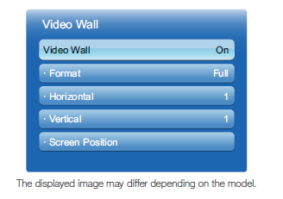
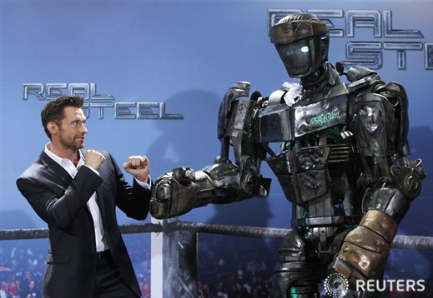
Optimized Connectivity “VW”
No need for additional equipment such as distributor
Simple videowall is possible with ‘videowall setting’ OSD menu (refer to following page)
Digital video signal
(DVI, HDMI)
DVI
HDMI
DP Loop Out
DP
DP loop out
Natural mode
Full mode

Slide 5
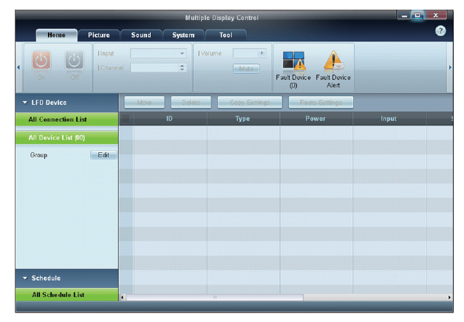
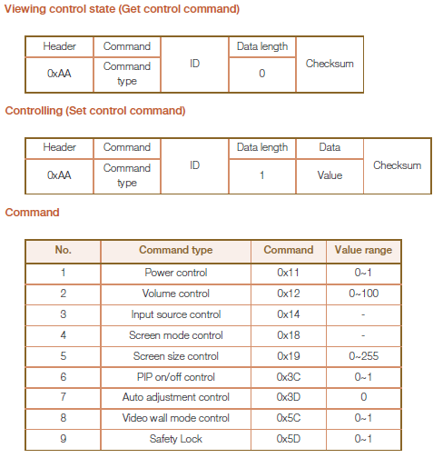
MDC
“Multi Display Control” Protocol is embedded in all SSS products
MDC program is provided as stand alone or imbedded within MagicInfo Suite
MDC (Multiple Display Control) Program
MDC(Multiple Display Control) Protocol

Slide 6
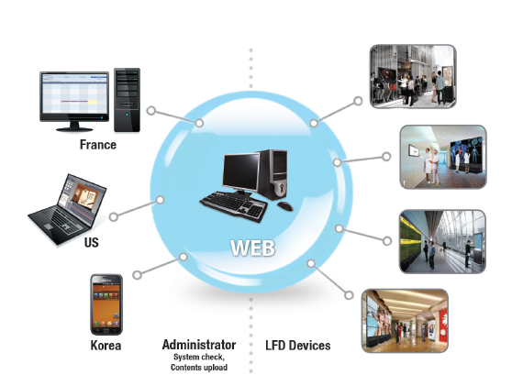
Digital Signage “SSSP”
“Offline” Content Management
“Offline” Scheduler
“ Offline” Template Manager
“MagicInfo” SW

Slide 7
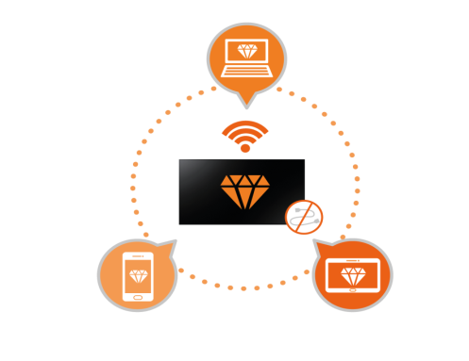
Other Differences
Display pivot for easier positioning
^{Easy Scalability}
^{WIRELESS CONNECTION}

Slide 8
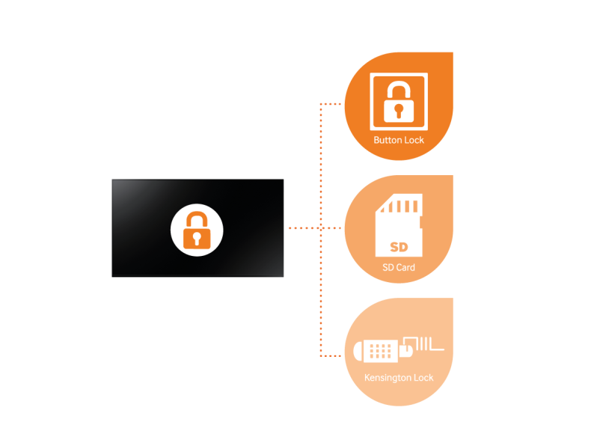
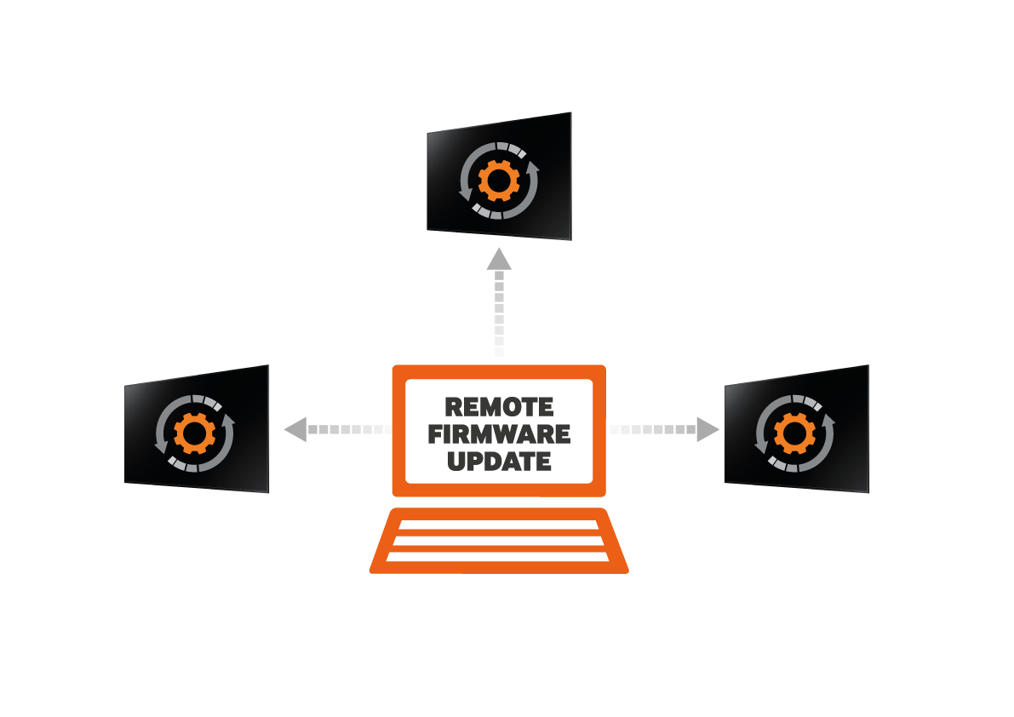
^{Better Security}
^{Touch Screen Overlay}
^{Remote FW Update}

