Slide 1
Erasmus+ Project
Project No: 561708-EPP-1-2015-1-DE-EPPKA2-CBHE-JP
Vocational Training for Undergraduate University Students and Teachers in Jordan (VTC)
Cloud Computing
Eng. Ahmad Al-Maddan.
Al Al-Bayt University - Computer Center.
Information Security and Quality Department .
Assistant Director
maddan@aabu.edu.jo

Slide 2
What you think about Cloud computing ?
“First to mind when asked what ‘the cloud’ is, a majority respond it’s either an actual cloud, the sky, or something related to weather.” – Citrix Cloud Survey Guide (August 2012).
So don’t be afraid if you didn’t got it from the first time.

Slide 3
Introduction
Started in the early of 2008
The computing resources become available, power full and less-cost as previously not.
This technological orientation leads to new model called cloud computing.
The rent and lent procedure between job owners and service providers.
The infrastructure providers and the service providers.

Slide 4
Cloud Computing Definition
NIST definition of cloud computing: “Cloud computing is a model for enabling ubiquitous(founded every where), convenient, on-demand network access to a shared pool of configurable computing resources (e.g., networks, servers, storage, applications, and services) that can be rapidly provisioned and released with minimal management effort or service provider interaction.”

Slide 5
More Simple
It is a service like your phone, electricity, water bell.
Don’t worry about the location of the sever, just turn-on your device and get your service.
The OUTSOURCING concept.

Slide 6
Cloud Computing Service Providers
Amazon
VMware
Microsoft
Google
Rackspace
IBM
Critix
Openstack

Slide 7
Cloud Computing Services
cloud storage
cloud database
cloud application

Slide 8
Cloud Computing Features
No up-front fees:
Pay for just what you rent.
Pay as you go.
No construction for the infrastructure.
Low operating cost:
Dynamic resources rent.
resources could be released dynamically to save money from wasted in a non-useable capacities.

Slide 9
Cloud Computing Features (cont.)
High scalable:
Rapid development in businesses.
Enable the service providers to develop and extend its service to manage and handle this rapid growth in service demands.
Easy access:
Applications well moves with the user.
Ease of access.
Any net-connected device.

Slide 10
Cloud Computing Features (cont.)
Reducing business risk and maintenance expenses:
Infrastructure providers take the risk.
Staff training cost.
Maintenance cost.

Slide 11
Cloud Computing Business Models
Infrastructure as a service (IaaS):
Delivers hardware resources such as CPU “Physically”, or virtual machines controlled by “HyperVisor” brought users by “cloud carrier”.
Disk space or network components as a service.
Client has full control of the virtualized platform.
Users are responsible of managing & maintaining their SW’s and OS’s
Platform as a service (PaaS):
Its provided by cloud provider.
Provide platform resources (application platform as a service) like operating systems and applications.
User can deploy and customize their applications (programming languages and tools supported by the cloud provider).
Users doesn’t have full control but they restricted by the provider constraints.

Slide 12
Cloud Computing Business Models (cont.)
Software as a service (SaaS):
Software (application) provide by the cloud provider (on-demand application),
The user just use it without any control.
This service can update, enhance, maintain and patching this software (applications).
Free applications.
Network as a service (NaaS):
Cloud services enabled the users to use network and transport connectivity services.
Optimization of resource allocations by considering network and computing resources as a unified whole (VPN, bandwidth on demand (BoD), and mobile network virtualization).

Slide 13
Cloud Computing Types

Slide 14
Cloud Computing Types
Public cloud (external cloud): 32%
Service providers offers their resources as a service to the public.
Shifting the risks to infrastructure providers.
Scalable and dynamic.
Lakes to the security.
Private cloud (internal clouds): 10%
Designed specifically for single origination(private network).
Organization has the highest degree of control over performance.
Reliability and security.
Organization well need to be charged for that service.

Slide 15
Cloud Computing Types (cont.)
Hybrid cloud: 58%
Combination of public and private cloud models.
Address the limitations of each approach.
Swings between both(Flexibility).
Offers the security and control over application data and expansion in capacity if needed.
Cloud Bursting: (application runs in a private cloud or data center and "bursts" to a public cloud in case of increasing demand of computing capacity)

Slide 16
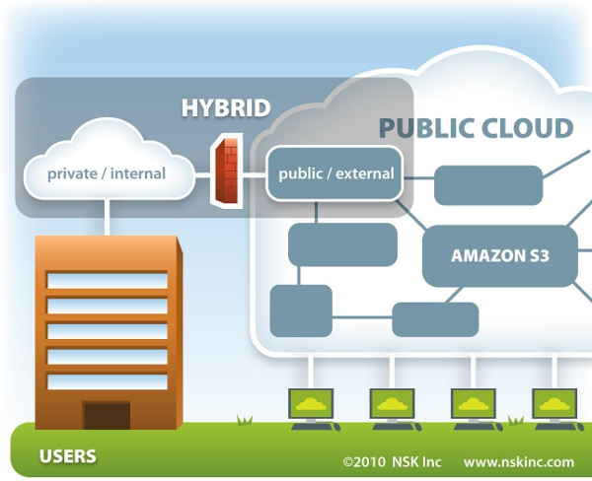

Slide 17
Public Clouds vs. Private Clouds
comparison | Public cloud | Private cloud
Initial cost | Typically zero | Typically high
Running cost | Predictable | Unpredictable
Customization | Impossible | Possible
Privacy | No (Host has access to the data) | Yes
Single sign-on | Impossible | Possible

Slide 18
Cloud Computing
Pros
Convenience (anywhere)
Backups
Collaboration (sharing)
Environmentally friendly
Cons
Security breaches
Outages
Slow speeds.
Limited features

Slide 19
The Future of Cloud Computing
Cloud computing is the future
“Clouded” systems
Expected operating systems is going to run on the cloud
People Fears of the roll of IT managers.
Cloud is a competitive player in the business.

Slide 20
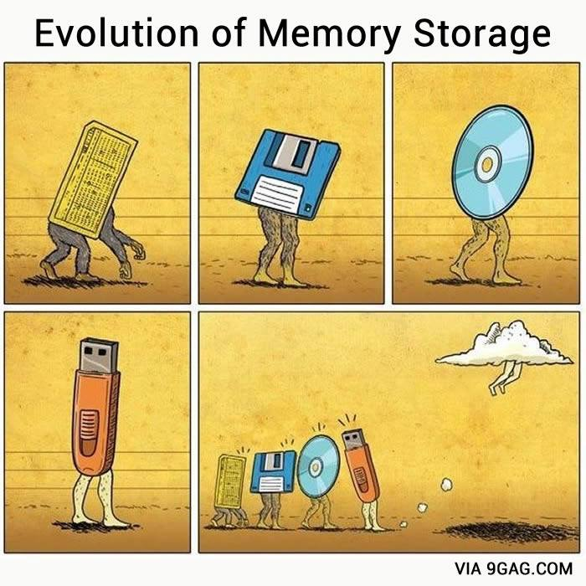

Slide 21
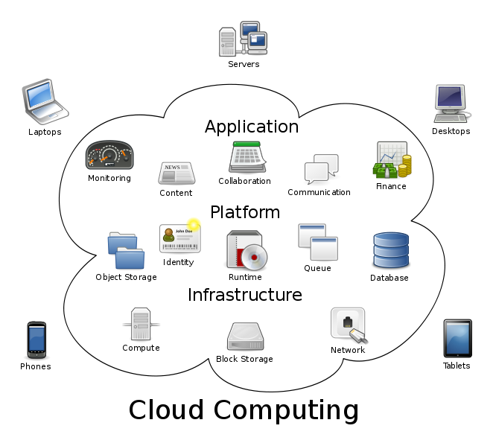

Slide 22
Can cloud be green ??
Yes,
due to Cloud computing business models (SaaS, NaaS, IaaS, PaaS)
Business Efficiency ➔ Energy Efficiency = Efficiency itself is Green.
virtualization (resource saving➔ cost saving➔ energy saving)

